Slide 1
Los Angeles Unified School District
ATTENDANCE MATTERS
Excellent Attendance Predicts Success:
The Important Role of Parents
Notes:
Say: Good morning or good afternoon, welcome to our presentation on the important role that you, as a parent play in your child’s school attendance.
My name is ___________________________. I am the Parent Leader assigned to this school. Today, I will be sharing some valuable information about school attendance.
I want to thank you for coming and supporting your child and their school success.

Slide 2
Objectives
Review the important roles you hold as students in your education
Build awareness about the District’s Attendance Improvement Plan 2018-19
Become familiar with District attendance goals
Become familiar with California laws related to attendance
Understand the Importance of regular school attendance
Build awareness on what schools can do to support attendance
Review what parents/caregivers can do to improve attendance
Become familiar with school attendance related resources that may help students attend school every day and on-time
Notes:
Explain objectives:
Today’s presentation will provide you with knowledge and information to help ensure your child attends school every day and on-time.
The reason we stress attendance so much is that the Los Angeles Unified School District (LAUSD) knows that student attendance and student achievement are closely intertwined. Students who develop patterns of good attendance are much more likely to be successful both academically and socially.

Slide 3
What Roles Students Play
Far Below Basic
Less that 87%
24 or more absences
It is in your hands
Role Model to others
Encourager for others
Notes:
Facilitator, for each bullet read the notes below:
First Teachers- parents are a child's first teacher and will continue to be his/her lifelong teacher. It is important to set aside time to offer to help
Cheerleader- children thrive on encouragement and yours, as the parent, is the most important
Role Model- children live by example. Teach or show them that learning is important for you as well; pick up a book to read or read together, and maintain regular communication with Teachers and school staff
Enforcer- set clear goals and expectations and help your child reach them by setting routines, limits and rewards Ensure your children do their homework.
Advocate- Meet with your children’s teachers and understand how they are doing in class. When speaking on your child’s behalf be mindful as to your tone of voice and language used to be respectful to others at all times

Slide 4
Attendance is a Top Priority for the 2020-2021 school year.
Notes:
Supt sent a team to develop a plan. The key is simple and consistency.

Slide 5
Educate All- This is Fundamental
The Plan builds a critical awareness throughout the Los Angeles Community of the importance of student attendance.
Schools share attendance information with their students, teachers and parents.
Everyone is responsible and accountable for student attendance.

Slide 6
Attendance Metric Goals
68%
14.6%
The 2018-19 District attendance goal is for:
70% or more of students with Excellent attendance (7 or less absences)
9% or less of students Chronically absent
(16 absences or more)
Schools will review the attendance goals results on a monthly basis

Slide 7
How Will We Make Progress
To help students improve their attendance every school will implement these practices:
Principals will send a Clear, Consistent Attendance message
Examples: Letters, Blackboard Connect Messages, Newsletters, PA announcements, Parent Meetings, Parent Teacher Conferences,
Back to School Night, Coffee with the Principal
School staff will make Phone Calls to a Targeted Student Group
Example: Target students who are chronically absent
School staff will encourage Targeted Group Intervention- Personalized connection/Mentoring Example: School staff visit student classroom
Notes:
Consistency is the key. Keep it simple. We want all the schools talking about the same practices so that
3 practices for all schools, 4 if it is an elementary school
Same consistent message- Keep it under 7.
Toolkit will be shared with you before August 7th
Making a connection with a school staff member
Reference the Kindergarten PPT and the flyer

Slide 8
Improving Attendance of
Every Student
Far Below Basic
Less that 87%
24 or more absences
This plan is about all schools providing the support to every student so that all students can improve their attendance.

Slide 9
LAUSD Attendance Goals
No more than 7 absences all year.
Notes:
The goal of every school is to reduce the parentages of students with chronic absenteeism.
The goal of every school is to increase the percentages of students with 96% or higher attendance rates.

Slide 10
Excellent Attendance=School Success
Far Below Basic
Less that 87%
24 or more absences
Below Basic
87-91%
16-23 absences
Basic
92-95%
8-15 absences
More likely to achieve and graduate
Proficient
96-99%
1-7 absences
Advanced
100%
0 absences

Slide 11
What Does California Law Say About School Attendance?
Compulsory Attendance Law
Mandatory Attendance California EC 48200
“Each person between the age of 6 and 18…shall attend the public full time day school or continuation school or classes for the full time designated…”
Notes:
Say: The law in California says all children between the ages of 6 and 18 must attend school . It is our responsibility as parents and guardians to make sure that our children do not miss school unless they have a valid excuse.
For additional information, refer to the School Attendance Brochure in your packet (in English and Spanish). You can also find important information about attendance related laws in California in the LAUSD Parent-Student Handbook.

Slide 12
Did you Know: California Law holds Parents Responsibe
According to
California Education Code 48260.5
the parent or guardian is obligated to compel the attendance of the pupil at school.
Notes:
Say: This means that parents, not the school are responsible for bringing their child to schools..

Slide 13
Why is Attendance Important?
Brainstorm with your table or elbow partners.
Share with each other why you should attend school and why attendance is important.
Notes:
Say: How many of you have seen this poster/image before? Do you know what it means?
Say: This poster was created to promote our District’s attendance campaign in order to help bring awareness of the importance of attendance to all our students, parents and staff. The slogan, “I Rise. I Attend. I Matter.” signifies our hope to empower each student to rise, attend every day, and create a life of meaning and purpose.
Facilitator: Have parents talk to an elbow partner and come up with some reasons why attendance is important.
Say: Please talk to an elbow partner for 2 minutes and come up with some reasons why attendance is important.
(Allow time for parents to talk at their table. Then ask for volunteers to share some of their answers. Write the answers on a large piece of paper or a whiteboard or blackboard)
Facilitator: Please chart answers given by parents (on blackboard*, whiteboard*, charting paper) and leave answers visible to discuss later. *If using a blackboard or white board please leave space for answers in coming slides*

Slide 14
If Students Are Not in School, They Cannot Learn
Students who are chronically absent in preschool, kindergarten, and first grade are less likely to read at grade level by third grade.
Students who do not read at grade level by the end of third grade are four times more likely than proficient readers to drop out of high school.
For everyone day missed, it takes a child three days or more to make up for lost instructional time.
Notes:
Say: Attendance strongly affects academic success in school, because if the student is not in class they cannot learn and fall behind.
Facilitator: Please ask for volunteers to read the bullet points

Slide 15
Potential Lifelong Consequences
Chronic Absence has been identified as a strong predictor of
low educational attainment, lower wages, higher unemployment
and in general, lower
quality of life.
Far Below Basic
Less that 87%
24 or more absences
Adapted from the National Center for School Engagement - Promoting attendance, attachment and achievement
Notes:
Say: Absence refers to all absences, whether they are excused or unexcused. Lost instruction due to chronic absence can lead to social and economic consequences well into adulthood. These consequences can occur even if the student had a valid reason to be absent.
Ask: What are some give examples of social and economic consequences?
Say: When your child is absent for any reason, they miss valuable instruction. When a child misses one day of school, it can take 3 days to catch up.
Ask: How many days will it take your child to catch up in school if they miss 3 days?

Slide 16
What Schools Do to Support Attendance
Far Below Basic
Schools are responsible for building safe, welcoming learning environments.
Support every individual student with their learning, and be available to support parents (talk with parents about their child’s progress regularly, teach parents to talk with their child about school every day)
Address factors that impact attendance by connecting families to school and community resources
Encourage students to attend school every day through strong teacher and staff connections
Less that 87%
24 or more absences

Slide 17
Why Are Students Absent?
Far Below Basic
Brainstorm with your table or elbow partners
Work together to list the factors that contribute to student absences.
Less that 87%
24 or more absences
Notes:
Say: What are common reasons that students miss school?
Facilitator: Have parents talk to an elbow partner and come up with some reasons why students are absent.
Say: Please talk to an elbow partner for 2 minutes and come up with some reasons you have heard as to why students are absent.
(Allow time for parents to talk at their table. Then ask for volunteers to share some of their answers. Write the answers on a large piece of paper or a whiteboard or blackboard)
Facilitator: Please chart answers given by parents (on blackboard*, whiteboard*, charting paper) and leave answers visible to discuss later. *If using a blackboard or white board please leave space for answers in coming slides*

Slide 18
Parent Engagement is Key
To Your Child’s Success
Far Below Basic
Less that 87%
24 or more absences
Research tells us that a student’s success in school is based not on the family’s income or social status, but on the family’s engagement in their children’s education
LAUSD recognizes that, when schools and parents form relationships, children are more likely to be successful in school
Notes:
Say: Parents’ involvement in their child’s education is very important and you as parents hold different roles.

Slide 19
What Parents Can Do
Parents are their child’s first teacher.
Talk regularly to your child about attending school every day so that they graduate from high school
Help your child to learn and get into the habit of regular routines
Plan family vacations during school breaks so that your child does not miss a day of learning
Attend parent-teacher conferences and regularly monitor your child’s progress (e.g., ask your child about their school day; if available, access your LAUSD parent portal)
http://passport.lausd.net

Slide 20
What Students Can Do
Students can.
Monitor your attendance by keeping a calendar of the days you are absent
Assist your teacher to take accurate attendance so that you are not marked absent by mistake
Get to school on time to make sure that you are not marked absent
Make a concerted effort to attend school every day so that you graduate from high school Develop regular routines and habits to help you be organized
Make sure that your family plans vacations during school breaks so that you do not miss a day of learning
http://passport.lausd.net

Slide 21
What Students Can Do?
Establish Morning and Evening Routines
Morning Routine | After School Routine | Bedtime Routine
Brush teeth | Unpack school bag | Pack school bag
Wash face and hands | Eat a snack | Get school clothes
Brush hair | Do homework | Brush teeth
Get dressed | Parents check homework | Put pajamas on
Make bed | Play | Parent and student read together
Eat breakfast | Eat Dinner | Lights out
On time for school | Shower | Early to bed
Far Below Basic
Less that 87%
24 or more absences

Slide 22
What Parents Can Do
Far Below Basic
Create a back-up system or alternate plans for getting to and from school
Make your school aware of any issues that may be affecting your child’s attendance for example: health and/or family problems
Make sure your child’s school has your accurate daytime contact information and address
Less that 87%
24 or more absences
Notes:
Facilitator: Read bullet points and stress the importance of informing the school when the change phone numbers and or move residence.

Slide 23
What Students Can Do
Far Below Basic
Ask your parents to schedule non-emergency medical and dental appointments after school hours on weekends or during vacation breaks
Ask your parents to bring you back to school after medical or dental appointments
Avoid unnecessary absences
Less that 87%
24 or more absences
Notes:
Facilitator: Read bullet points
After the second bullet point Facilitator: If the child’s appointment must be during school hours, please have your child attend school prior to the appointment and return to school after the appointment to complete the school day if at all possible.

Slide 24
Remind your Parents to communicate with the school if you are absent
Far Below Basic
Less that 87%
24 or more absences
It is the parent’s responsibility to notify the school when you are absent
Provide a doctor’s note
Write a note explaining the reason for the absence
Call the school to inform them of the reason for the absence (write down the name of the person you spoke to)
Provide court documentation if you must appear in court
Always keep track of you absences on a calendar
Notes:
Say: It is important to make sure that you communicate the reason for your child’s absence to the school as soon as possible, preferable within 10 days. Please keep in mind that all absences, excused or unexcused, are recorded and reported in the District’s report to the State.

Slide 25
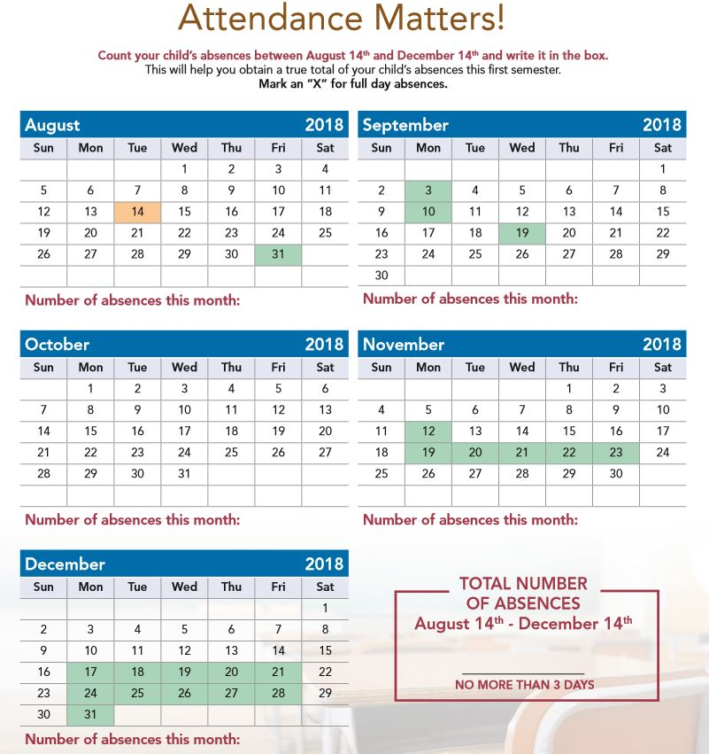
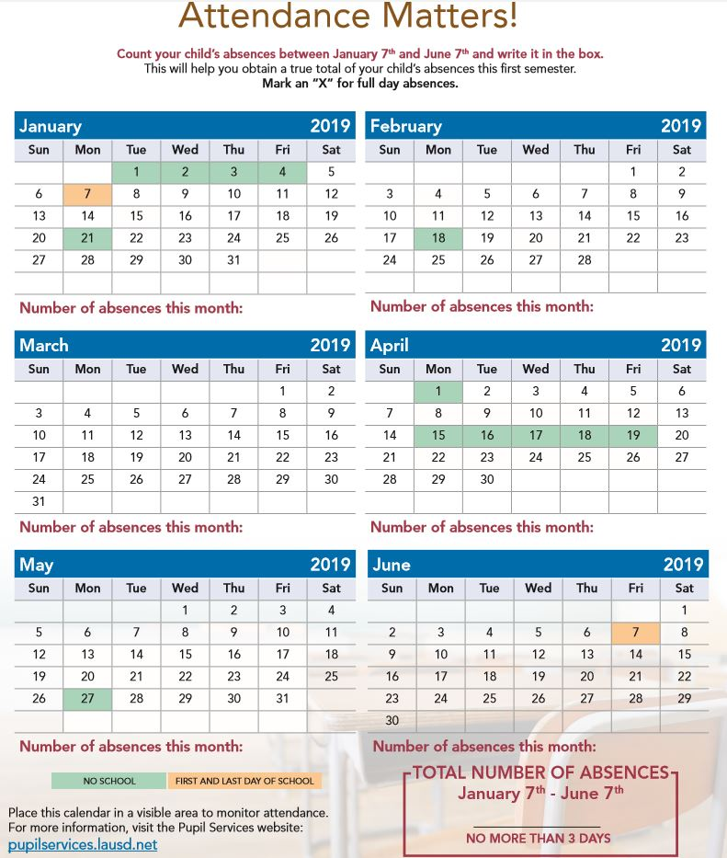
School Site Resources
Monthly Calendar
Far Below Basic
Less that 87%
24 or more absences
Notes:
Facilitator Pass out the handout of this slide and Say:
This Resource Directory is a tool to identify support services at our school.
Now lets work in small groups to fill in the names of support staff here at the school
Keep in mind, not each school has every resource, so some areas of this worksheet may be blank for your school.
Group Activity Directions:
Have the audience/parents break up into groups of 3-4 people per group.
Have them complete this worksheet by filling in the boxes of the names of support staff they know are at your school.
After 5-8 minutes stop the activity and review the worksheet together.
Say:
Also in your packet is a monthly calendar designed especially for parents. The calendar can be used to help you keep track of your child’s absences.
Please review calendar with parents

Slide 26
Principal
Insert Name:___________________
Counselor
Insert Name: ___________________
Psychiatric Social Worker (PSW)
Insert Name:_____________________
Teachers
Insert Name:__________________
Student
Dean
Insert Name:___________________
Pupil Services and Attendance Counselor
(PSAC)
Insert Name:_______________________
Nurses
Insert Name:___________________
Who can parents speak to regarding attendance concerns?
Parent Center Representative
Insert Name:_____________________
Parent
Who Can Support you with Attendance?
Notes:
Facilitator Say:
It is important for you as a parent to know who in your school site addresses your child’s attendance…
Please refer to our “School Site Resource Directory” as to who you as the parent can speak to about attendance related questions or concerns

Slide 27
President Obama’s Speech to Congress
“In the end, there is no program or policy that can substitute for a mother or father who will attend those parent/teacher conferences, or help with homework after dinner or turn off the TV, put away the video games and read to their child.”
“It’s family that first instills the love of education in a child.”
Notes:
Facilitator: Read President Obama’s quote
Say: You are one of the most important factors in your child’s success at school. Your child needs your attention and involvement at school, so please continue to participate in meetings like this. Continue to show your children how much you care about their education and how deeply you believe in their ability to succeed.

Slide 28
Comments or Questions?
Thank You!
Notes:
Say: Thank you very much for your time and attention. We are grateful for the opportunity to present this information to you, and look forward to continuing our partnership to support our students and families.

Slide 29
If students are not in school, they cannot learn.
Every day is important.
Keep it under 7.
Every day matters.
Far Below Basic
Less that 87%
24 or more absences

